Slide 1

Mission Planning, Military Decision Making Process and Troop Leading Procedures

Slide 2
Where to Begin
Troop Leading Procedures
Deliberate/Hasty Planning
Orders, Rehearsals, and Brief Backs
Utilize Planning Tools
Find, Fix, Finish, Exploit, Analyze, and Disseminate (F3EA) Targeting Methodology

Slide 3
Troop Leading Procedures
Criticality
Accessibility
Recoverability
Vulnerability
Effect
Recognizability
TLP
Receive the Mission
Issue the WARNO
Make a tentative plan
Initiate movement
Conduct recon
Complete the Plan
Issue OPORD
Supervise/Rehearse
Situation
Mission (5 Ws)
General Instructions
Specific Instructions
Timeline
Analytical Tools
METT-TC
-Mission
-Enemy
-Time
-Terrain (OCOKA)
-Troops
-Civilian Considerations
PMESII-PT
-Political
-Military
-Economic
-Social
-Information
-Infrastructure
-Physical Environment
-Time
COAs
-Feasible
-Acceptable
-Suitable
-Complete
-Distinct
OPTION #1
RAPID PR PLANNING
1. Mission/Situation analysis
2. Develop a COA
3. Refine and validate the COA
4. Implement
-SMEAC
-COA Sketch
OPTION #2
DELIBERATE PLANNING
Mission Analysis
Situation Analysis
COA Development
COA Analysis (wargame)
COA Comparison
Decision

Slide 4
Troop Leading Procedures
1: Receive the Mission
Perform an initial assessment of the situation (Verify and Validate information)
Analyze: CARVER (Criticality-Accessability-Recoverabilty-Vulnerability-Effect-Recognizability)
Answer the 5 Ws: Who-What-When-Where-Why
Commander’s Intent is most important to ID
Obtain/analyze relevant information
METT-TC
PMESII-PT
Allocate time available for planning and preparation

Slide 5
Troop Leading Procedures
2: Issue WARNORD
Outlines what team needs to do right now to support planning and preparation
Don’t delay just to wait for additional information, brief the team when you have relevant data
Initial WARNORD format:
Situation
Mission
General (TC)/Specific (TL) Instructions
Timeline
Situation may dictate more/less detail (METT-TC)

Slide 6
Troop Leading Procedures
2 Cont: Issue WARNORD
Situation
Minimum details are given to include only the information the team needs to prepare
Mission
Brief but clear statement of what the team is to accomplish and the location or area in which it is to be done
Should answer the 5 W’s
General (TC)/Specific (TL) Instructions
General and special organization (i.e. equipment carried by all vs. equipment carried by team member)
Timeline
Times and places for rehearsals, inspections, etc.

Slide 7
Troop Leading Procedures
2 Cont: Issue WARNORD
Timeline considerations
Determine the useable time available to both you and your subordinates
Identify Critical Times such as:
Key times dictated by HHQ
Briefs/Rehearsals
Aircraft Take off
Reverse Planning - Build your timetable starting with the conclusion of the mission and working backwards with identified critical times to present time
Use Time Management Tools
1/3 rule-1/3 of time allocated for planning, and 2/3 of time allocated for preparation/movement
Modern information systems, team architecture, standing TTP/SOPs may allow for a 1/5 – 4/5 planning ratio

Slide 8
Troop Leading Procedures
3: Make Tentative Plan
RAPID PLANNING (Crisis Response Operations)
Default to the logic that a timely and effective solution is more important than the optimal solution through detailed planning/COA development
TC/TLs must determine when to apply rapid versus detailed planning
Steps to rapid plan development for Crisis operations:
Perform mission and situation analysis (METT-TC)
Develop a COA (Insert/Infil/AOO/Exfil/Extract)
Refine and validate the COA
Implement
Note: TLP steps may occur simultaneously/continuously

Slide 9
Troop Leading Procedures
4: Initiate Movement
Initiate any movement necessary
To continue mission preparation
Position the team for execution
Provide clear and purposeful direction
Initial movement is usually sometime before making a tentative plan
Essential when time is short

Slide 10
Troop Leading Procedures
5: Conduct Reconnaissance
Minimum action necessary is a map/imagery study
Gather information from any assets on scene
When time and circumstances allow
Use UAS live video feed in JOC, or any other assets available
Focus on information gaps identified during mission analysis

Slide 11
Troop Leading Procedures
6: Complete Plan/7: Issue OPORD
Step 6 - Complete the Plan
Incorporate the results of planning time/analysis/recon into the selected COA
Make final coordination with adjacent units and HHQ
Step 7 - Issue OPORD
5 Paragraph format: Situation, Mission, Execution, Admin/LG, Command/Signal (SMEAC)
Supplemented by COA sketch if time permits
Normally issued verbally if time sensitive response

Slide 12
Troop Leading Procedures
8: Supervise/Rehearse/Refine
Conducted throughout all TLP steps
Supervise and assess mission/team preparation
Perform coordination with adjacent units
Rehearsal of Concept (ROC drill)
Go over Insertion Plan
Actions on the Objective (AOO)
Terrain model use
Communications checks (minimum rehearsal)
Refine the plan

Slide 13
METT-TC
Mission– (Raid, Ambush, Recce, etc.)
Enemy – (Composition, Disposition, Strength)
Troops – (Assets Available, your own troops capabilities/limitations)
Time – (Utilize backwards planning, find Decision Points)
Terrain – (OCOKA)
Civilians – (Friendly/enemy, target discrimination, etc.)

Slide 14
OCOKA (Terrain Analysis)
Obstacles (cliffs, rivers, etc.)
Cover and Concealment
Discriminate between cover and concealment, identify for routes and Actions on Objective
Observation and Field of Fire (for Recon, Observation Post, etc.)
Know both friendly and enemy weapon system maximum effective ranges, find dead space (where your weapons, or enemies weapons cannot reach)
Key Terrain (gives decisive tactical advantage to you or the enemy)
Avenues of Approach (identify routes for both friendly and enemy forces, consider escape routes as well)

Slide 15
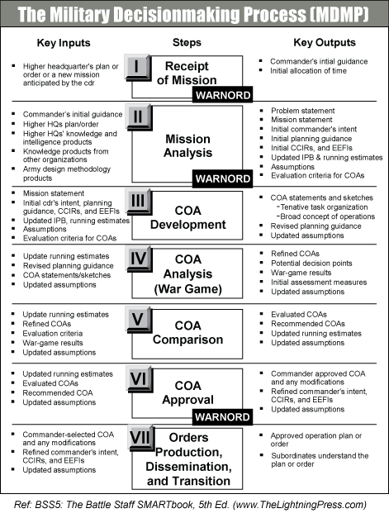
CDR’s Estimate Process

Slide 16
Decision Making Process
Mission Analysis
COA Development
COA Synchronization/Wargame
OPORD Development
Rehearse

Slide 17
Mission Analysis
Mission Analysis
Assets available
Identify specified and implied tasks
Identify constraints placed on mission by others
Identify limitations of your own team
List facts and assumptions
Restate the mission relative to your team

Slide 18
Course of Action Development
COA Development/Selection/Decision
METT-TC
Come up with multiple COAs
Include Task Org, Concept Sketch, Pros/Cons, and Timeline
Determine selection criteria
Utilize a decision matrix and rank/rate each COA against every aspect (I.E. speed, surprise, simplicity, etc)
Can weigh certain factors more or less depending on CDR’s Intent/Mission Analysis
Decide on the COA

Slide 19
COA Synch/Wargame
Synchronizing
List assets against timeline in a synch matrix
Identify what assets/your team will be doing at those times
Identify friction points to find RFI’s and emplace control measures/utilize assets to the utmost
Wargame
Against the enemy’s most likely COA
Identify flaws in the plan/timing in synch matrix

Slide 20
OPORD Development
OPORD
Situation – Overall situation going on in AOR. Think METT-TC and include recent reports
Mission – A brief sentence that succinctly answers the 5 W’s of what the team is to execute
Execution – The most important piece of the OPORD – Gives a detailed plan of what the team is to do from the start of the mission to the end
Support/Admin/Logistics – Gives troop sustainment, supply requests, etc.
Command and Control– Location of CC, succession of command, comm’s signals, etc.

Slide 21
Rehearse
Rehearse
Group Leader Briefs
Key leaders in the group will brief their key tasks in the mission
Rehearsal of Concept (ROC) Drill
Team will rehearse concept of mission
Communications Check
Time will dictate how in depth rehearsals will be

Slide 22
Summary
Begin with TLP’s (METT-TC, OCOKA, etc.)
MDMP
Mission Analysis
COA Development (Decide on COA)
COA Synch/Wargame
OPORD Development
Situation, Mission, Execution, Admin, Command and Control
Rehearse

